Slide 1
Tut 4
Decision Constructs

Slide 2
Tut 4
By default the instructions in a program are executed sequentially.
However, in serious programming situations, seldom do we want the instructions to be executed sequentially.

Slide 3
Tut 4
Many a times, we want a set of instructions to be executed in one situation, and an entirely different set of instructions to be executed in another situation.
This kind of situation is dealt in C programs using a decision control instruction.

Slide 4
Tut 4
A decision control instruction can be implemented in C using:
The if statement
The if-else statement
The conditional operators

Slide 5
if construct
The general form of if statement looks like this:
if ( this condition is true )
execute this statement ;

Slide 6
if construct
The keyword if tells the compiler that what follows is a decision control instruction.
If the condition, whatever it is, is true, then the statement is executed.
If the condition is not true then the statement is not executed; instead the program skips past it.

Slide 7
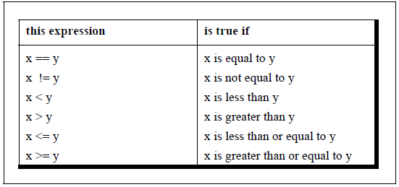
if construct
As a general rule, we express a condition using C’s ‘relational’ operators.
The relational operators allow us to compare two values
to see whether they are equal , unequal, or whether one is greater than the other

Slide 8
if construct
Note that = is used for assignment,
whereas, == is used for comparison of two quantities.

Slide 9
Program 1
/* Demonstration of if statement */
main( )
{
int num ;
printf ( "Enter a number less than 10 " ) ;
scanf ( "%d", &num ) ;
if ( num <= 10 )
printf ( “Hey you lost the game!" ) ;
}

Slide 10
if statement
if ( expression )
statement ;
The expression can be any valid expression including a relational expression.
We can even use arithmetic expressions in the if statement.

Slide 11
if statement
All the following if statements are valid
if ( 3 + 2 % 5 )
printf ( "This works" ) ;
if ( a = 10 )
printf ( "Even this works" ) ;
if ( -5 )
printf ( "Surprisingly even this works" ) ;

Slide 12
if statement
All the following if statements are valid
if ( 3 + 2 % 5 )
printf ( "This works" ) ;
The expression evaluates to 5 and since 5 is non-zero it is considered to be true.
Hence the printf( ) gets executed.

Slide 13
if statement
if ( a = 10 )
printf ( "Even this works" ) ;
10 gets assigned to a so the if is now reduced to
if ( a ) or if ( 10 ).
Since 10 is non-zero, it is true hence again
printf( ) goes to work.

Slide 14
if statement
if ( -5 )
printf ( "Surprisingly even this works" ) ;
In the third if, -5 is a non-zero number, hence true.
So again printf( ) goes to work.
In place of -5 even if a float like 3.14 were used it would be considered to be true

Slide 15
if statement
Note that in C a non-zero value is considered to be true, whereas a 0 is considered to be false.
So the issue is not whether the number is integer or float, or whether it is positive or negative.
Issue is whether it is zero or non-zero.

Slide 16
Program 3
While purchasing certain items, a discount of 10% is offered if the quantity purchased is more than 1000. If quantity and price per item are input through the keyboard, write a program to calculate the total expenses.

Slide 17
Program 3
#include<stdio.h>
void main()
{
int qty,dis=0;
float Total,price ;
printf("\n Enter the Quantity = ");
scanf("%d",&qty);
printf("\n Enter Price per item =");
scanf("%f",&price);
if(qty>1000)
{
dis=10;
}
Total=(qty*price)-(qty*price*dis/100);
printf("Total expenses=Rs. %f",Total);
}

Slide 18
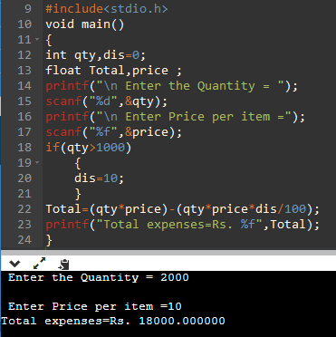
Output

Slide 19
Program
The current year and the year in which the employee joined the organization are entered through the keyboard. If the number of years for which the employee has served the organization is greater than 3 then a bonus of Rs. 2500/- is given to the employee. If the years of service are not greater than 3, then the program should do nothing.

Slide 20
/* Calculation of bonus */
main( )
{
int bonus, cy, yoj, yr_of_ser ;
printf ( "Enter current year and year of joining " ) ;
scanf ( "%d %d", &cy, &yoj ) ;
yr_of_ser = cy - yoj ;
if ( yr_of_ser > 3 )
{
bonus = 2500 ;
printf ( "Bonus = Rs. %d", bonus ) ;
}
}

Slide 21
If else Statement
if(condition)
{
--
--
--
}
else
{
--
--
--
}

Slide 22
Program 2
In a company an employee is paid as under:
If his basic salary is less than Rs. 1500, then HRA = 10% of basic salary and DA = 90% of basic salary.
If his salary is either equal to or above Rs. 1500, then HRA = Rs. 500 and DA = 98% of basic salary.
If the employee's salary is input through the keyboard
Write a program to find his gross salary.

Slide 23
Program 2
/* Calculation of gross salary */
main( )
{
float bs, gs, da, hra ;
printf ( "Enter basic salary " ) ;
scanf ( "%f", &bs ) ;
if ( bs < 1500 )
{
hra = bs * 10 / 100 ;
da = bs * 90 / 100 ;
}
else
{
hra = 500 ;
da = bs * 98 / 100 ;
}
gs = bs + hra + da ;
printf ( "gross salary = Rs. %f", gs ) ;
}

Slide 24
Program 4
The marks obtained by a student in 5 different subjects are input through the keyboard. The student gets a division as per the following rules:
Percentage above or equal to 60 - First division
Percentage between 50 and 59 - Second division
Percentage between 40 and 49 - Third division
Percentage less than 40 - Fail
Write a program to calculate the division obtained by the student.

Slide 25
Method – I Nested if-elses
main( )
{
int m1, m2, m3, m4, m5, per ;
printf ( "Enter marks in five subjects " ) ;
scanf ( "%d %d %d %d %d", &m1, &m2, &m3, &m4, &m5 ) ;
per = ( m1 + m2 + m3 + m4 + m5 ) / 5 ;
if ( per >= 60 )
printf ( "First division ") ;
else
{
if ( per >= 50 )
printf ( "Second division" ) ;
else
{
if ( per >= 40 )
printf ( "Third division" ) ;
else
printf ( "Fail" ) ;
}
}
}

Slide 26
Method – I Nested if-elses
This leads to three disadvantages:
As the number of conditions go on increasing the level of indentation also goes on increasing. As a result the whole program creeps to the right.
Care needs to be exercised to match the corresponding ifs and elses.
Care needs to be exercised to match the corresponding pair of braces.
All these three problems can be eliminated by usage of ‘Logical operators’.

Slide 27
Method – II Logical Operators
main( )
{
int m1, m2, m3, m4, m5, per ;
printf ( "Enter marks in five subjects " ) ;
scanf ( "%d %d %d %d %d", &m1, &m2, &m3, &m4, &m5 ) ;
per = ( m1 + m2 + m3 + m4 + m5 ) / 5 ;
if ( per >= 60 )
printf ( "First division" ) ;
if ( ( per >= 50 ) && ( per < 60 ) )
printf ( "Second division" ) ;
if ( ( per >= 40 ) && ( per < 50 ) )
printf ( "Third division" ) ;
if ( per < 40 )
printf ( "Fail" ) ;
}

Slide 28
Method – II Logical Operators
In the second if statement, the && operator is used to combine two conditions.
‘Second division’ gets printed if both the conditions evaluate to true.
If one of the conditions evaluate to false then the whole thing is treated as false.
if ( per >= 60 )
printf ( "First division" ) ;
if ( ( per >= 50 ) && ( per < 60 ) )
printf ( "Second division" ) ;
if ( ( per >= 40 ) && ( per < 50 ) )
printf ( "Third division" ) ;
if ( per < 40 )
printf ( "Fail" ) ;
}

Slide 29
Method – II Logical Operators
Two distinct advantages in favour of this program:
The matching (or do I say mismatching) of the ifs with their
corresponding elses gets avoided, since there are no elses in
this program.
In spite of using several conditions, the program doesn't creep to the right.

Slide 30
The else if Clause
main( )
{
int m1, m2, m3, m4, m5, per ;
printf();
scanf();
per = ( m1+ m2 + m3 + m4+ m5 ) / 5 ;
if ( per >= 60 )
printf ( "First division" ) ;
else if ( per >= 50 )
printf ( "Second division" ) ;
else if ( per >= 40 )
printf ( "Third division" ) ;
else
printf ( "fail" ) ;
}

Slide 31
The else if Clause
This program reduces the indentation of the statements.
In this case every else is associated with its previous if.
The last else goes to work only if all the conditions fail.

Slide 32
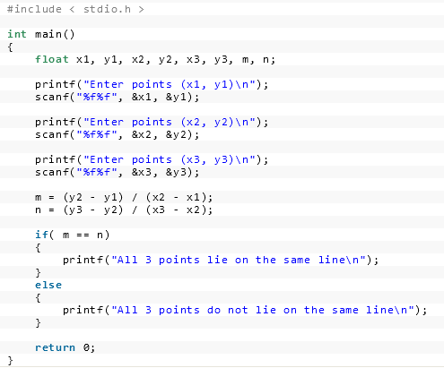
Given 3 points (x1,y1),(x2,y2) and (x3,y3) Write a C Program to check if all the 3 points fall on one straight line.

Slide 33
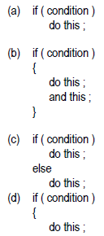
if statement
The if statement can take any of the following forms:

Slide 34
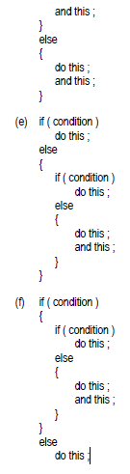
if statement
The if statement can take any of the following forms:

Slide 35
The Conditional Operators
The conditional operators ? and :
Also called ternary operators
Since they take three arguments.
In fact, they form a kind of foreshortened if-then-else.
Syntax-
expression 1 ? expression 2 : expression 3

Slide 36
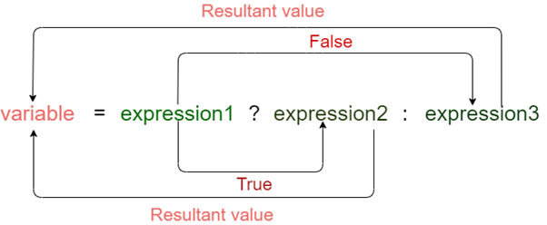
The Conditional Operators
Syntax-
expression 1 ? expression 2 : expression 3
What this expression says is:
“if expression 1 is true (that is, if its value is non-zero),
then the value returned will be expression 2,
otherwise the value returned will be expression 3”.

Slide 37
The Conditional Operators
int x, y ;
scanf ( "%d", &x ) ;
y = ( x > 5 ? 3 : 4 ) ;
This statement will store 3 in y if x is greater than 5,
otherwise it will store 4 in y.
The equivalent if statement will be,
if ( x > 5 )
y = 3 ;
else
y = 4 ;

Slide 38
The Conditional Operators
#include <stdio.h>
int main()
{
int age; // variable declaration
printf("Enter your age");
scanf("%d",&age);
(age>=18)? (printf("eligible for voting")) : (printf("not eligible for voting")); // conditional operator
return 0;
}

Slide 39
Switch case construct
The control statement that allows us to make a decision from the number of choices is called a switch,
Or a switchcase- default,
Since these three keywords go together to make up the control statement.
Used to write Menu Driven Programs
As provides a Menu

Slide 40
Switch case construct
switch ( integer expression )
{
case constant 1 :
do this ;
case constant 2 :
do this ;
case constant 3 :
do this ;
default :
do this ;
}

Slide 41
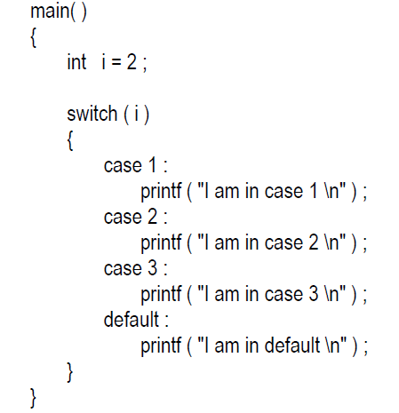
Switch case construct

Slide 42


Switch case construct
The output is definitely not what we expected!
We didn’t expect the second and third line in the above output.
The program prints case 2 and 3 and the default case.

Slide 43
Switch case construct
Well, yes. We said the switch executes the case where a match is found
and all the subsequent cases and the default as well.

Slide 44
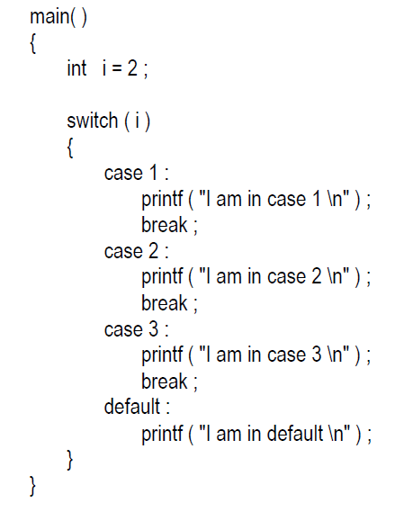

Switch case construct
If you want that only case 2 should get executed,
It is upto you to get out of the switch then and there by using a break statement.

Slide 45
Switch case construct
Note that there is no need for a break statement after the default, since the control comes out of the switch anyway.

Slide 46
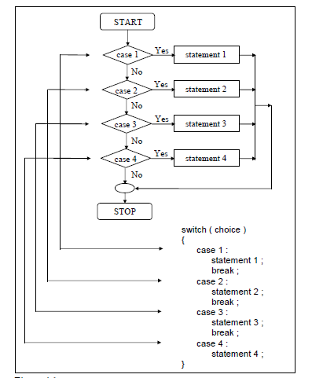
Switch case construct

Slide 47
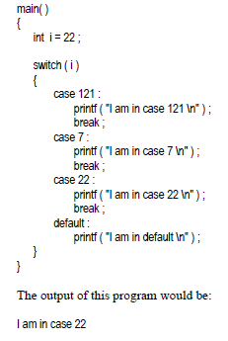
Switch case construct
You can in fact put the cases in any order you please.
An example of scrambled case order

Slide 48
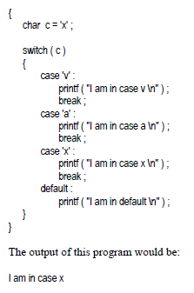
Switch case construct
main()
You are also allowed to use char values in case and switch

Slide 49
Switch case construct
main()
In fact here when we use ‘v’, ‘a’, ‘x’ they are actually replaced by the ASCII values (118, 97, 120) of these character constants.

Slide 50
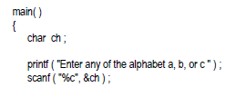
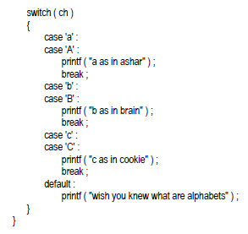
Switch case construct
At times we may want to execute a common set of statements for multiple cases.

Slide 51
Switch case construct
Once a case is satisfied the control simply falls through the case till it doesn’t encounter a break statement.
That is why if an alphabet a is entered the case ‘a’ is satisfied and since there are no statements to be executed in this case the control automatically reaches the next case i.e. case ‘A’ and executes all the statements in this case.

Slide 52
Switch case construct
Restaurant Menu
Calculator Menu

